Slide 1



Music Machine Learning
II – Neural networks
Master ATIAM - Informatique
Philippe Esling (esling@ircam.fr)
Maître de conférences – UPMC
Equipe représentations musicales (IRCAM, Paris)

Slide 2
Neural Networks
An attempt to mimic « intelligence » in biology
You might have seen this in crappy movies
So why modeling biological neurons ?...
Well it is the only « intelligent » thing we know ☺
First model of neuron trace back to 1943 (McCulloch & Pitts)
Then went slightly into disappearance
Backpropagation algorithm & NetTalk
Sparked back the interest ~1990
Nowadays deep learning and connexionnism
Seems like the best way to go upwards strong AI.

Slide 3
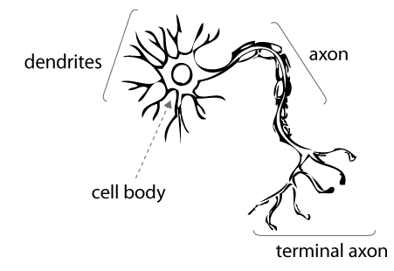
Neural Networks

Slide 4
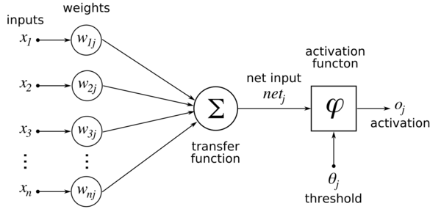
Neural Networks

Slide 5
Neural Networks

Slide 6
Neural Networks

Slide 7
Neural Networks

Slide 8
Neural Networks
Seminal model by McCulloch & Pitts (dating back to 1943)
So what does a single neuron mathematically do ?

Slide 9
Neural Networks
So what is the interpretation of this equation?
Let’s say I only have a single weight (+ threshold)?
1
With N inputs, a single neuron simply defines a
N-dimensional hyperplane
So essentially a space division (classification) but also a function approximation
(as the sum will give an output whatever X comes in)

Slide 10
Neural Networks
So neurons allow to divide the space …
So neurons allow to perform classification
But also function approximation
(as the sum will give an output for all X)
Only linearly separable problems
But how can a neuron learn ?
0
1
1
0
0
1
1
0
By tweaking the weights we can separate any two classes
(only if they are linearly separated)

Slide 11
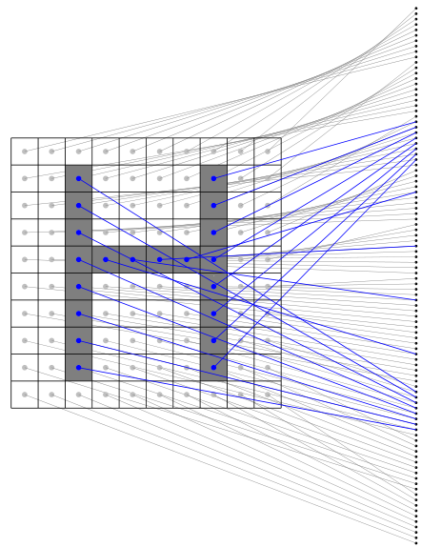
Neural Networks
Optical Character Recognition (OCR) example
H
H ?
1

Slide 12
Neural Networks
But how to learn the weights?
Learning is possible through weight optimization
This is possible as
This is done through a training phase
We have a set of input vectors
For which we know the desired output
Therefore we can compute the error
So training amounts to adjust so that
We can do that easily using gradient descent ☺

Slide 13
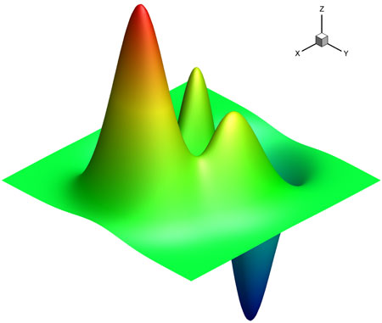
Neural Networks
Gradient descent is path following
Need to find the lowest error point
This amounts to error minimization
Look around different directions
Compute the difference in error
« Climb hills » and back-propagate
Two problems remain from the original definition.
Problem 1 = There is a threshold T for each neuron
Problem 2 = Conditions on the error shape for gradient descent
The space needs to be continuous

Slide 14
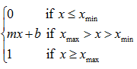
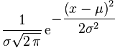
Neural Networks
Problem 1 = There is a threshold T for each neuron
Solution : We consider T as a virtual weight (w₀)
Problem 2 = Conditions on the error shape for hill climbing
The space needs to be continuous
Solution : Simply needs to use different activation functions
Piecewise linear
Sigmoïd
Gaussian

Slide 15
Neural Networks

Slide 16
Neural Networks
Architecture
Space region
XOR Problem
General shapes
Single layer
Two layers
Three layers

Slide 17
Neural Networks
To learn, we have to look at the effect of weight modification on errors
So we need the derivatives
Look at the shape of error surface
Evaluate this in each dimension
Then follow the hills (change weights)
Back-propagate the effect

Slide 18
Neural Networks
The derivative of the output is only
a function of itself ☺

Slide 19
Neural Networks
Amount of work is a linear function of the depth of the network
Sigmoïd helps to simplify the computations

Slide 20
Neural Networks
So how to code your own (single) neuron?
Initialize and to small random values
While !(stop condition)
Present patterns to neuron
Propagation: Evaluate its output and error
Back-propagation: Update the weights based on
Stop conditions
Iterations number
learn rate ([0,1])
output
desired
This extends quite simply to multi-layer networks
We simply need to take into account the multiple layers
So the propagation is iterative and back-propagation also

Slide 21
Neural Networks
So how to code your multilayer perceptron
Initialize to small random values
Randomly choose an input pattern from the training set
Present patterns to the network
Propagation: Evaluate its output and error
Compute the in the output (last) layer ( )
Back-propagate by computing deltas for preceding layers
Update weights in the corresponding layers
derivative of activation
Net input to i^{th} unit in Lth layer

Slide 22
Learning rules
So far we have used the simplest learning rule
Error-correction
Learning occurs when the perceptron makes an error
We use the error signal
But other rules can be implemented
Hebbian rules
If neurons on both sides of a synapse are activated
Then the synapse strength is increased
Learning is done locally with synchronicity
Weights change only for two connected neurons
This amounts to learn the maximal variance
Orientation
selectivity
0

Slide 23
Learning rules
Boltzmann learning
Works on symmetric recurrent networks
Each neuron is a stochastic unit
Output based on Boltzmann distribution of statistical mechanics
Two modes exist for each neuron
Clamped: fixed to specific states
Free-runing: Adjust weight so that clamped states satisfy PDF
Competitive learning
Unlike other rules, here neurons compete
Only one output unit is active at any given time
Each output connected to all inputs and all other outputs
This implies inhibitory weights and self-feedback
The unit with largest output wins
Implies tradeoff between plasticity and stability

Slide 24


Slide 25
Neural Networks
Neural networks
Feed-forward
Recurrent/feedback
Single-layer
perceptron
Multilayer
perceptron
Radial Basis Functions
Competitive
networks
Kohonen’s
SOM
Hopfield
network
ART models

Slide 26
Different architectures
Radial Basis Function (RBF) Network
Special case of feed-forward network
Follows the multilayer perceptron structure
Usually 2 layers architecture
Activation function is a gaussian kernel
Both and must be learned
2-step hybrid learning strategy
Unsupervised clustering for and
Supervised Least Mean Squares (LMS)

Slide 27
Different architectures
Recurrent/Feedback Network
Connections can go backwards
Self-connections are also allowed
Allows retro-action but can also model
Time dependency notions
Different network states

Slide 28
Different architectures
Kohonen’s Self-Organizing Maps (SOM)
Each neuron connected to all neurons
But distance between neurons is kept
And this distance influences the network
Models relations of spatial neighborhood
Local neurons influence more than global
Embeds a property of topology preservation

Slide 29
Different architectures

Slide 30
Different architectures
Adaptive Resonance Theory (ART) models
Form of competitive network
Not all outputs neuron are used (only if necessary)
Difference between commited and uncommited
Only update a category if prototypes simlar
The extent of similarity is controled by vigilance P
Competitive layer
Auxiliary
A
Comparison layer
R
Reset
Input

Slide 31
Part 2
Advanced networks
Master ATIAM - Informatique
Philippe Esling (esling@ircam.fr)
Maître de conférences – UPMC
Equipe représentations musicales (IRCAM, Paris)

Slide 32
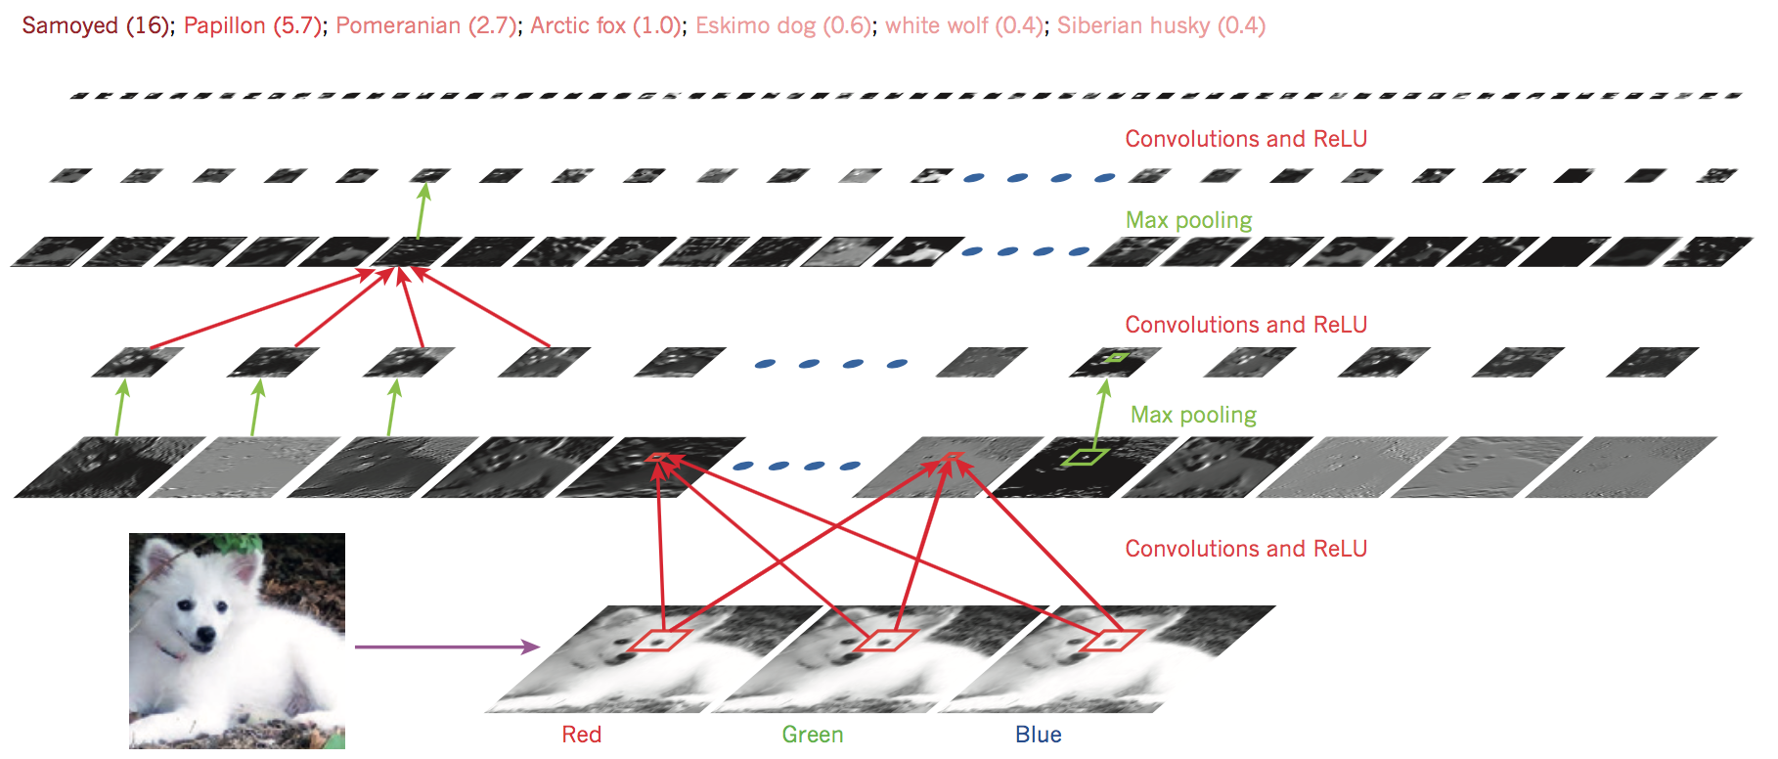
Convolutional neural networks
Convolutional Neural Networks use convolutions (!)
For processing data with a grid-like or array topology
CNNs include three key ideas related to natural signals:
Local connections, Shared weights, Pooling
32

Slide 33
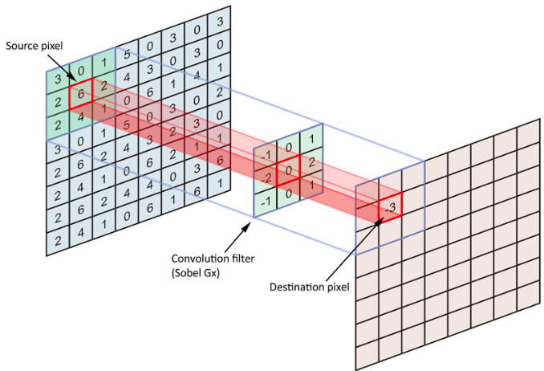
Convolutions – operator
Convolution operator is defined as a series of local products
This acts as a filter or feature detector
Each filter is convolved across the input data, producing a feature map.
Can be seen as sliding a small kernel over a larger matrix
33

Slide 34


Convolutions – parameters
Some major parameters that influence the behavior of convolutions
Size of the kernel (height, width)
Padding (adding zeros to preserve dimensionality)
Stride (hop size of application)
Dilation (extent of application)
padding
stride
dilation
34

Slide 35
Convolutional networks
Convolutional networks are defined by these layers
We replace linear layers by convolutional ones
As previously, we apply a non-linearity between layers
And also eventually some pooling
35

Slide 36
Convolutions – pooling
Convolutions largely increase the dimensionality
We add a pooling operation to summarize regions
This also provides translational invariance
Allows to have an increasingly large receptive field
36

Slide 37
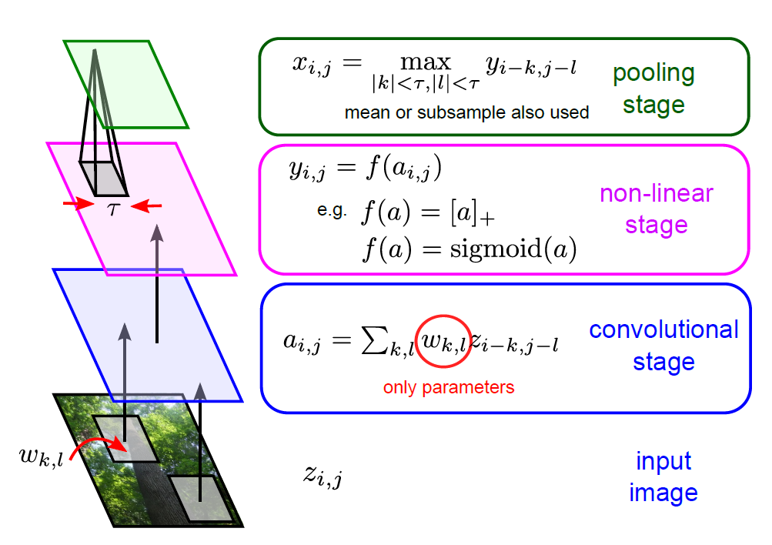
Convolutional networks
37

Slide 38
Recurrent neural networks
How can networks process temporal inputs ?
We would like to introduce some time dependencies
Hence, we need to compute a form like
Introduce loops, but problem for backpropagation
Idea of “unfolding” recurrent networks
38

Slide 39
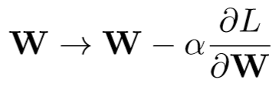
Backpropagation Through Time
Objective is to update the weights
Issue: W occurs each timestep
Every path from W to L is one dependency
Find all paths from W to L!

Slide 40
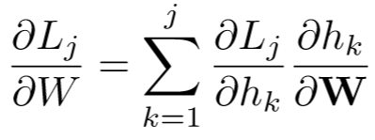
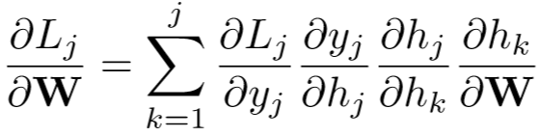
Backpropagation Through Time
j
No explicit of L_{j} on h_{k}
Use chain rule to fill missing steps
k

